Slide 1
Responsive Web Design
Mendel Rosenblum
CS142 Lecture Notes - Responsive Web Design

Slide 2
Web App Challenges: Screen real estate
1920x1028
768x1024
320x640
768x1024
640x320
Cell Phones Desktops
Tablets
Do we need to build N versions of each web application?
CS142 Lecture Notes - Responsive Web Design

Slide 3
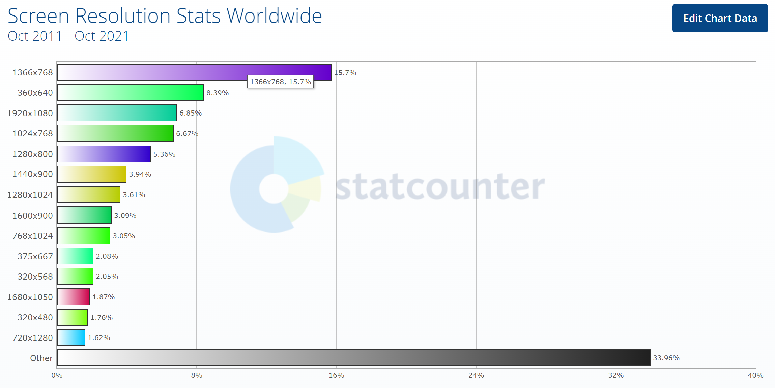
CS142 Lecture Notes - Responsive Web Design

Slide 4
Responsive Web Design
Context is like water!
  The web app should flow into and fill whatever device you have.
Possible with recent CSS extensions:
  Add grid layout system with relative (e.g. 50%) rather than absolute (e.g. 50pt) measures
    Specify element packing into columns and rows
  Add @media rules based on screen sizes
    Switch layout based on screen size
  Made images support relative sizes
    Autoscale image and videos to fit in screen region
img { width: 100%; height: auto; } video { width: 100%; height: auto; }
CS142 Lecture Notes - Responsive Web Design

Slide 5
Example of Responsive Web Layout
Menu #1 - 25% | Menu #2 - 25% | Menu #3 - 25% | Menu #4 - 25%
Nav #1 - 25% | View component - 75%
Nav #2 - 25%
Nav #3 - 25%
Footer - 100%
Menu #1 - 25% | Menu #2 - 25% | Menu #3 - 25% | Menu #4 - 25%
Nav #1 - 25% | View component - 75%
Nav #2 - 25%
Nav #3 - 25%
Footer - 100%
CS142 Lecture Notes - Responsive Web Design

Slide 6
CSS Breakpoints
Menu #1 - 100%
Menu #2 - 100%
Menu #3 - 100%
Menu #4 - 100%
 | Nav #1 - 25% | View component - 75%
 | Nav #2 - 25%
 | Nav #3 - 25%
Footer - 100%
CSS Rules:
@media only screen and (min-width: 768px) {
/* tablets and desktop layout */ }
@media only screen and (max-width: 767px) {
/* phones */ }
@media only screen and (max-width: 767px) and (orientation: portrait) {
/* portrait phones */ }
CS142 Lecture Notes - Responsive Web Design

Slide 7
Responsive implementation
Build components to operate at different screen sizes and densities
  Use relative rather than absolute
  Specify sizes in device independent units
Use CSS breakpoints to control layout and functionality
  Layout alternatives
  App functionality conditional on available screen real estate
Mobile first popular
  Expand a good mobile design to use more real estate
CS142 Lecture Notes - Responsive Web Design

